Slide 1
Methodology to prepare Existing Landuse Map/
Draft Development Plan
A case of Bhanwarpur Rurban Cluster
Government of Chhattisgarh
Panchayat & Rural Development Department
Nava Raipur,Atal Nagar, Chhattisgarh

Slide 2
Content of the Presentation
Spatial Plan preparation Methodology
Plan Preparation Status
Planning Area Notification
Regional Setting
Existing Land Use
Demand Gap Analysis & Projections
Spatial Plan
Issues & Recommendation

Slide 3
Spatial Plan preparation Methodology
Procurement of Satellite imagery
GIS Mapping -Preparation of Base map
Preparation of Existing land use plan
Data Collection, studies and surveys
Analysis and Assessment of Existing situation
Public participation and consultation
Preparation of conceptual plan
Preparation of Proposed Land Use Plan
Review of Master Plan in vogue

Slide 4
Planning Area Notification
  Planning Area Delineation of all 18 clusters completed
  Formulation of Planning Area under section 13(1) of T&CP Act, 1973 – 11 Clusters
  Preparation of Draft Existing Landuse Plan – 06 Clusters
  Publication of Existing Landuse Plan under section 15(1) of T&CP Act, 1973 – 03 Clusters
  Notification of Existing Landuse Plan under section 15(4) of T&CP Act, 1973 – 02 Clusters
  Enforcement of Chhattisgarh Bhoomi Vikas Niyam, 1984 – 10 Clusters.

Slide 5
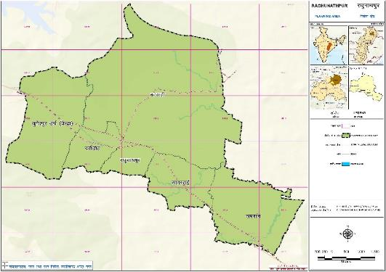
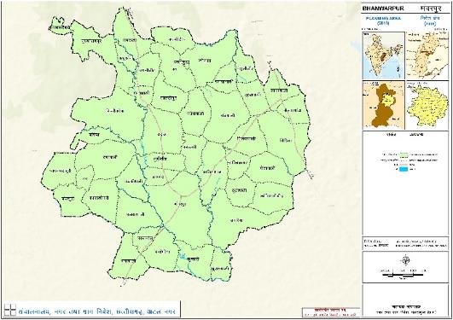
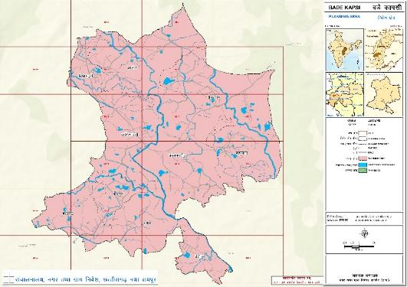
Regional Setting
RAGHUNATHPUR
Sr. no. | Cluster | Location (District) | Area (Sq.km.) | Population
1 | Kunda | Kabeerdham | 111.01 | 31632
2 | Loharsi | Dhamtari | 36.63 | 34778
3 | Madpal | Bastar | 90.09 | 25945
4 | Murmunda | Rajnandgaon | 73.82 | 23835
5 | Badekapasi | Kanker | 12.60 | 9273
6 | Hardibazar | Korba | 24.77 | 12810
7 | Raghunathpur | Sarguja | 38.65 | 9410
8 | Jetha | Janjgir-Champa | 22.84 | 28812
9 | Bhanwarpur | Mahasamund | 110.45 | 25187
10 | Sonhat | Koriya | 32.99 | 25179
11 | Jairamnagar | Bilaspur | 8.67 | 11373
12 | Miriguda | Raigarh | 52.58 | 8809
13 | Badekanera | Kondagaon | 31.50 | 10497
14 | Palideeh | Jashpur | 14.29 | 13672
15 | Mandirhasaud | Raipur | 18.00 | 18378
16 | Basantpur | Balrampur | 45.35 | 9821
17 | Rampur | Dhamtari | 31.62 | 29666
18 | Birkona | Kabirdham | 35.22 | 21678
BHANWARPUR
BADEKAPSI

Slide 6
Plan Preparation Status
S. | Planning Stage | No. of Cluster | Name of Cluster
1 | Delineation of Area | 18 | Kunda, Loharsi, Madpal, Murmunda, Badekapasi, Hardibazar, Raghunathpur, Jetha, Bhanwarpur, Sonhat, Jairamnagar, Miriguda, Badekanera, Palideeh, Mandirhasaud, Basantpur, Rampur, Birkona
2 | Formulation of Planning Area u/s 13(1) | 14 | Kunda, Loharsi, Murmunda, Madpal, Badekapasi, Hardibazar, Raghunathpur, Jetha, Bhanwarpur, Sonhat, Jairamnagar, Miriguda, Badekanera, Mandirhasaud
3 | Enforcement of BVN, 1984 | 10 | Kunda, Murmunda, Badekapasi, Hardibazar, Raghunathpur, Jetha, Bhanwarpur, Sonhat, Miriguda, Badekanera
4 | Draft ELU | 6 | Kunda, Murmunda, Badekapasi, Raghunathpur, Bhanwarpur, Badekanera (in progress)
5 | Publication of ELU u/s 15(1) | 3 | Badekapsi, Raghunathpur, Bhawarpur
6 | Notification of ELU u/s 15(4) | 2 | Badekapsi, Bhawarpur
7 | Merged with adjoining Planning Area | 7 | Loharsi, Madpal, Palideeh, Mandirhasaud, Basantpur, Rampur, Birkona
8 | Master plan prepared u/s 19(5) | 1 | Mandirhasaud
9 | Technical Issues Related (Under Rectification) | 3 | Hardibazar, Jetha, Sonhat

Slide 7
STAGES OF PREPARATION OF DEVELOPMENT PLAN
Governed under CG Town and Country Planning Act, 1973
Delineation of Planning Area
u/s 13
STAGE - I
Freezing of Existing Landuse
u/s 15(4)
STAGE - II
Preparation of Development Plan
Preparation of Structure Plan
STAGE - III
u/s 14
u/s 73 (Govt Order)
lapkyuky;] uxj rFkk xzke fuos’k] vVy uxj] NRrhlx<+

Slide 8
PLANNING STAGES
STAGE - I
Delineation of Planning Area

Slide 9
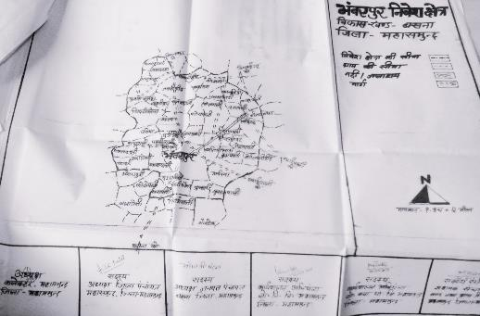
DELINEATION OF PLANNING AREA
Majmuli Naksha

Slide 10
PLANNING AREA DETAILS – AREA AND POPULATION
Sr. no. | Village Name | Area (in Ha) | Population
1 | Bamhanindih | 188.18 | 647
2 | Bandabari | 175.51 | 518
3 | Bansulidih | 148.91 | 370
4 | Barhaguda | 11.03 | 0
5 | Bartiyabhatha | 340.08 | 883
6 | Bhalukona (Bhalukonha) | 78.93 | 108
7 | Bhanwarpur | 768.40 | 3712
8 | Bichhiya | 492.42 | 1570
9 | Bijrabhantha | 159.56 | 411
10 | Chandkhuri | 205.48 | 631
11 | Chapiya | 139.53 | 285
12 | Chipari Ona | 595.17 | 1567
13 | Dhamanghutkuri | 236.22 | 647
14 | Dhanapali | 267.72 | 729
15 | Harilchhapar | 133.05 | 294
16 | Jamdarha | 248.98 | 705
17 | Jamnidih | 179.13 | 687
18 | Jharband | 119.02 | 492
19 | Kanda Dongar | 279.58 | 313
20 | Karrabhouna | 259.49 | 863
21 | Kelwardabari | 55.12 | 187
22 | Khogasa | 406.58 | 1105
23 | Khusarupali | 136.38 | 491
24 | Koliyaridih | 261.24 | 718
25 | Kumhari | 262.14 | 582
26 | Lohadipur | 220.22 | 530
27 | Medhapali | 270.50 | 806
28 | Mudidih | 169.71 | 362
29 | Padkipali | 202.83 | 396
30 | Palsabhadi | 139.87 | 509
31 | Palsapali | 316.99 | 700
32 | Paraskol | 106.35 | 250
33 | Paterapali | 254.14 | 614
34 | Pilwapali | 252.82 | 569
35 | Purushotampur | 388.69 | 894
36 | Rupapali | 411.10 | 1011
37 | Sagarpali | 194.27 | 937
38 | Sanbahali | 94.30 | 379
39 | Santpali | 444.87 | 1379
40 | Sukhapali | 186.07 | 988
41 | Thuthapali | 179.63 | 533
42 | Udela | 435.57 | 1156
43 | Umariya | 525.03 | 1359
 | Sub total | 10940.81 | 31887
 | Forest | 357.36
 | Total PA | 11298.17

Slide 11
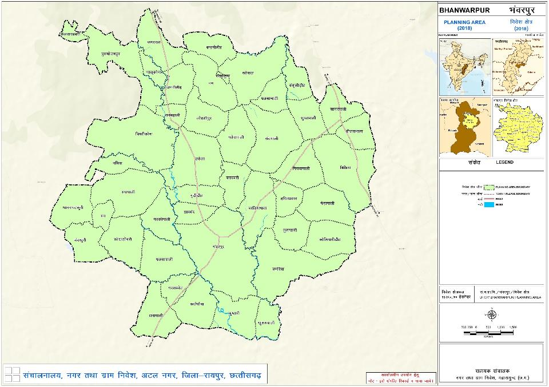
PLANNING AREA MAP

Slide 12
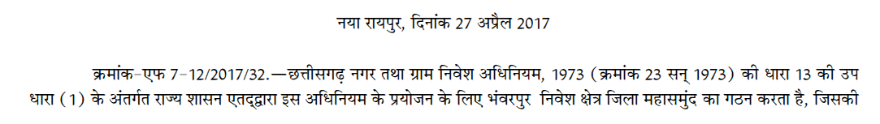
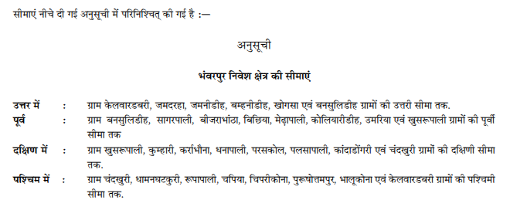
DELINEATION OF PLANNING AREA
Notification u/s 13 (1)

Slide 13
PLANNING STAGES
STAGE - II
Preparation of Existing Landuse Map

Slide 14
PREPARATION OF EXISTING LANDUSE MAP/ BASE MAP
  Procurement of Shape file having cadastral information from DT&CP
  Validation of cadastral information based on Notified Document u/s 13(1)
  Procurement of Satellite image of the Planning Area
  Geo-referencing / Superimposition of cadastral information over satellite image
  Digitisation of Geo-referenced Map to get Final Base Map
  Validation of Draft ELU through NUIS data/ Bhuvans/ Bhunaksha/ any other data provided by DT&CP
  Field verification of Draft ELU before publication
  Publication of draft ELU u/s 15(1) for receiving O/S
  Scrutiny of O/S & Rectification in Draft Base Map accordingly
  Notification of Final ELU u/s 15(4).

Slide 15
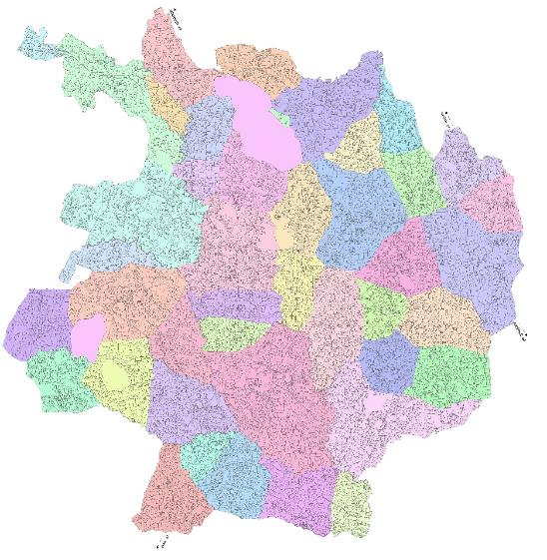
Procurement of Shape file from CHIPS
PREPARATION OF EXISTING LANDUSE MAP/ BASE MAP
CHIPS provide Cadastral data in about 17 layers , mainly -
Abadi
Canal
Forest
Gramin Abadi
Grass Land
Hilly Area
Island
Parcel
River
Road
Shamshan/Kabristan
Talab Bund
Water Bodies
Scrub Land, etc.
Khasra no.
Landuse categories
Administrative Boundaries
Natural Features
Road Network
Area and so on..

Slide 16
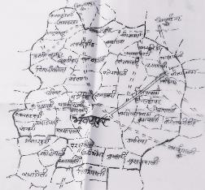



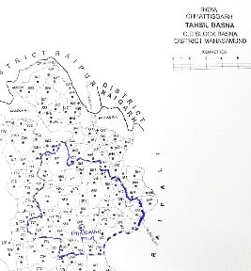
Validation of cadastral information & Village boundary
PREPARATION OF EXISTING LANDUSE MAP/ BASE MAP
CHIPS DATA
Notification Document 13(1)
Majmuli Naksha
Census Atlas
lapkyuky;] uxj rFkk xzke fuos’k] vVy uxj] NRrhlx<+

Slide 17
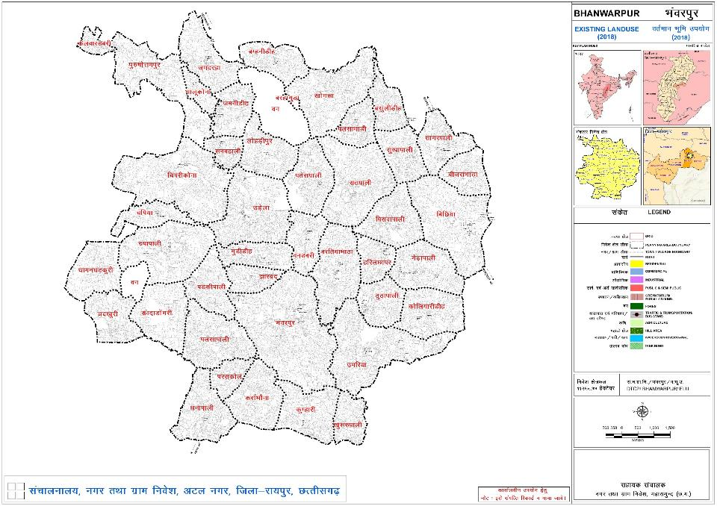
Planning Area with Khasara/ Cadastral details

Slide 18
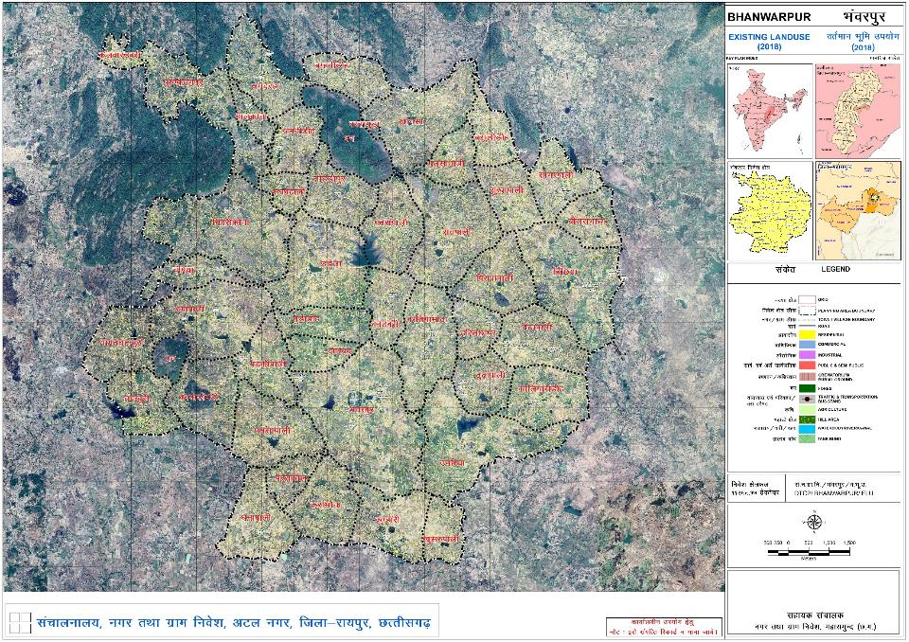
Superimposition of Cadastral data on Satellite Image

Slide 19
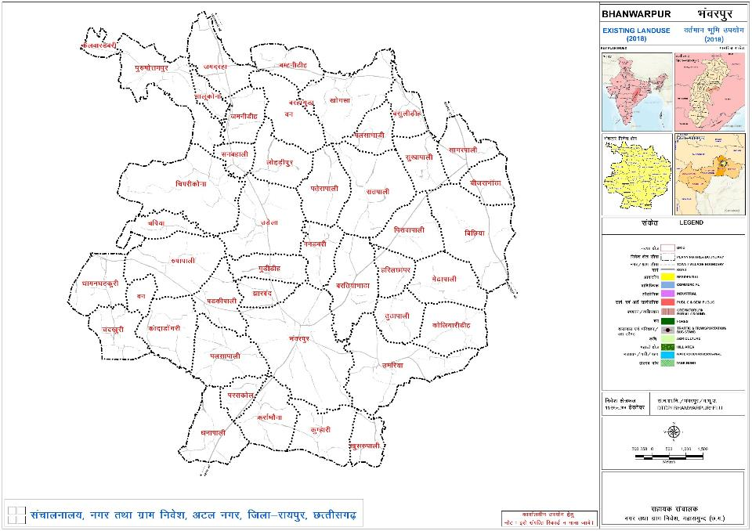
Digitisation of Circulation Pattern

Slide 20
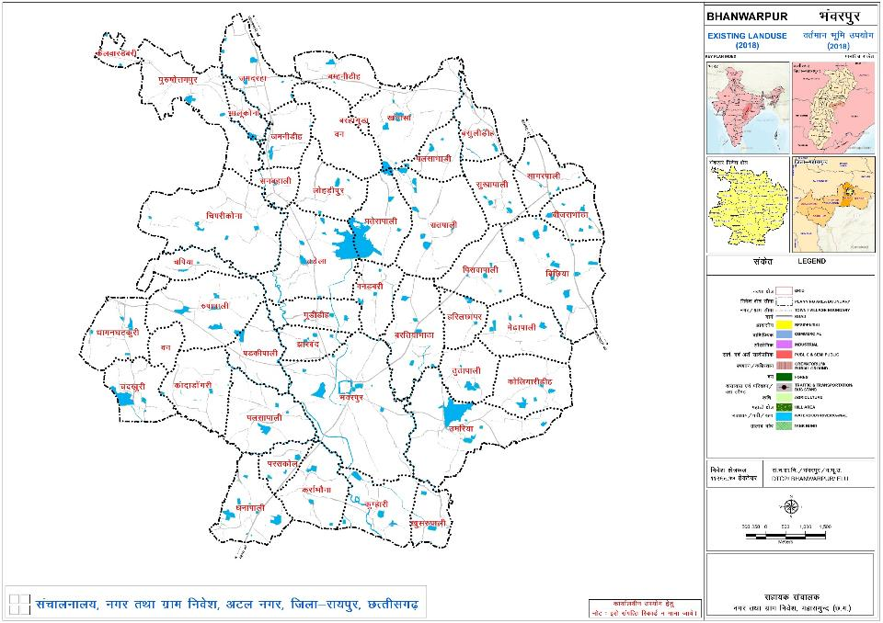
Digitisation of Natural Features

Slide 21
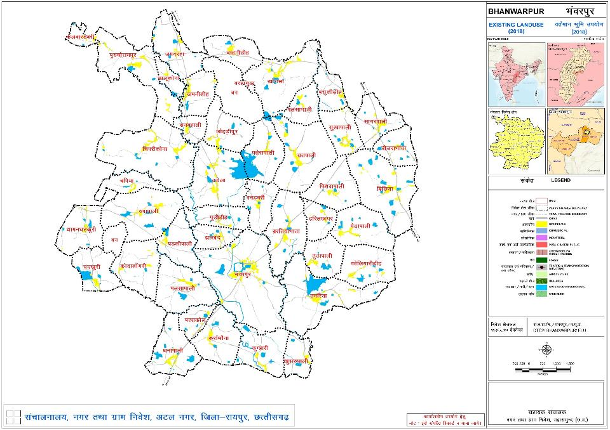
Digitisation of Residential Builtup Area

Slide 22
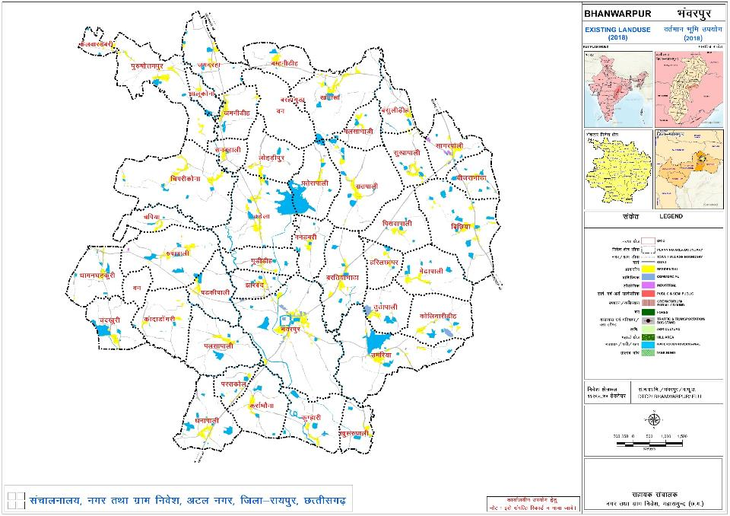
Digitisation of Commercial/ Industrial Areas

Slide 23

Digitisation of Public & Semi Public Builtup Area

Slide 24
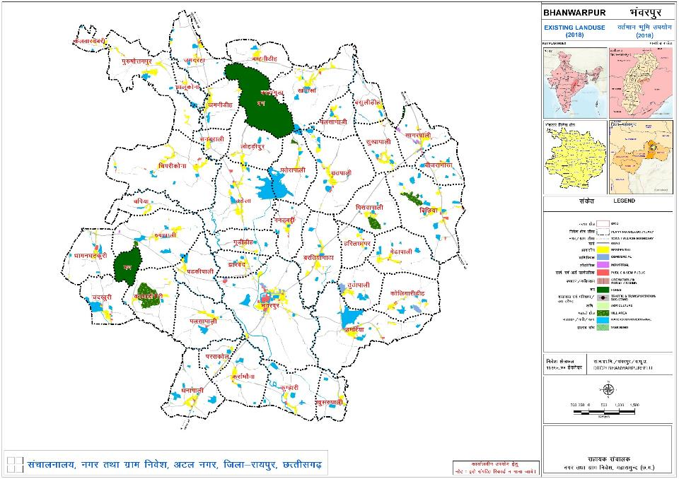
Digitisation of Forest/ Hills

Slide 25
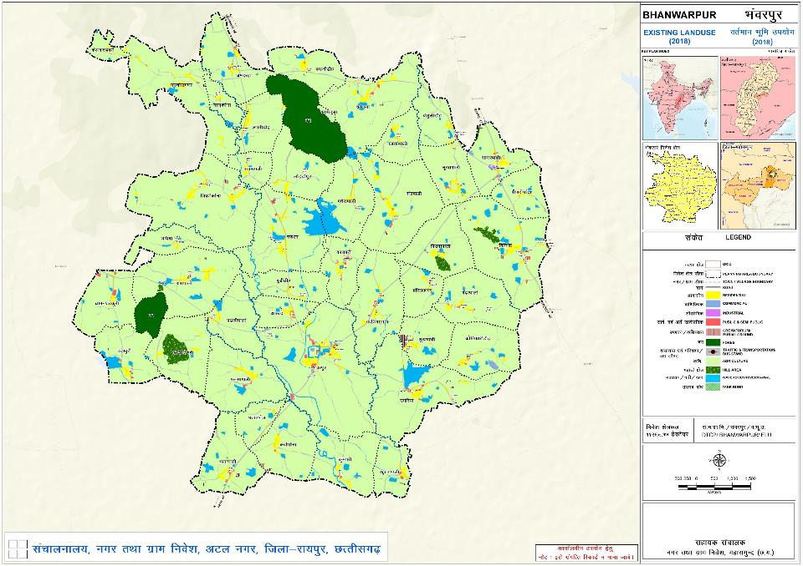
Draft Existing Landuse Map for field verification

Slide 26
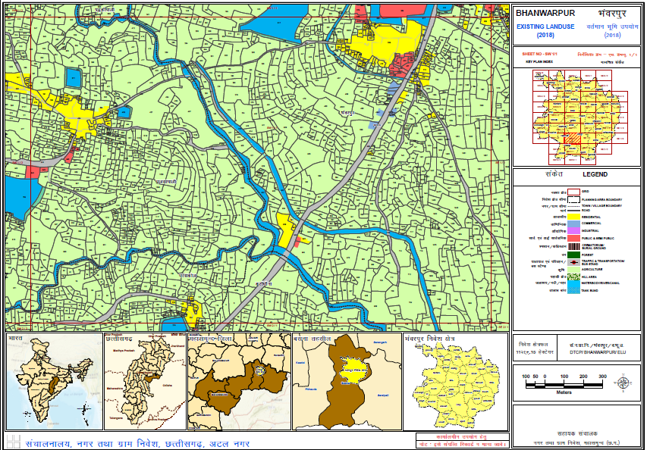
Draft Existing Landuse on 1:4000 scale Grid Map

Slide 27
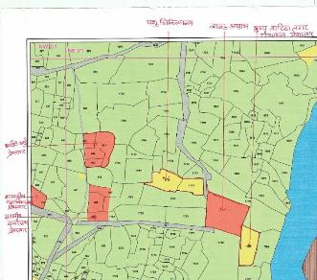
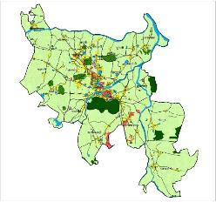
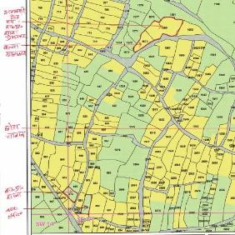
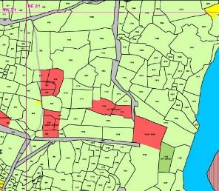
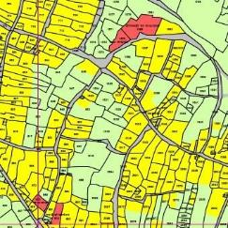
Validation of Draft ELU by Patwari and
Field Verification of Draft ELU @ 1:4000 scale and modification as per verified data
lapkyuky;] uxj rFkk xzke fuos’k] vVy uxj] NRrhlx<+

Slide 28
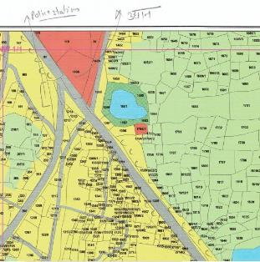
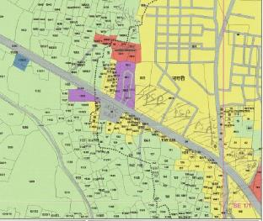
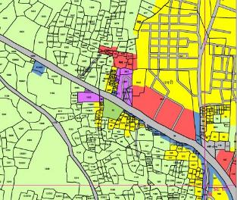
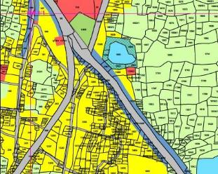
Validation of Draft ELU by Patwari and
Field Verification of Draft ELU @ 1:4000 scale and modification as per verified data

Slide 29

Publication of Draft Existing Landuse Map u/s 15(1)
Public display for 30 days to receive Objections and Suggestions

Slide 30
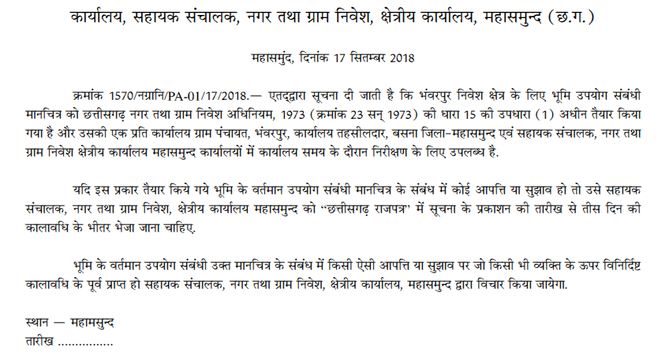
Gazette Notification of Draft ELU u/s 15(1)

Slide 31
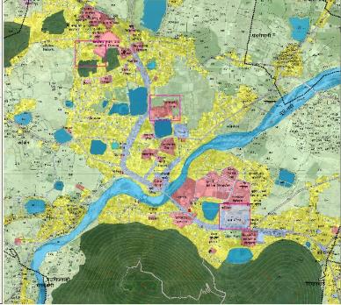
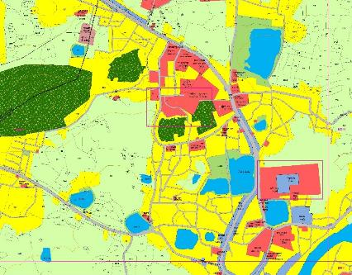
Hearing of O/S received and Modification of Draft ELU as per approved O/S

Slide 32

Final ELU u/s 15(4)

Slide 33
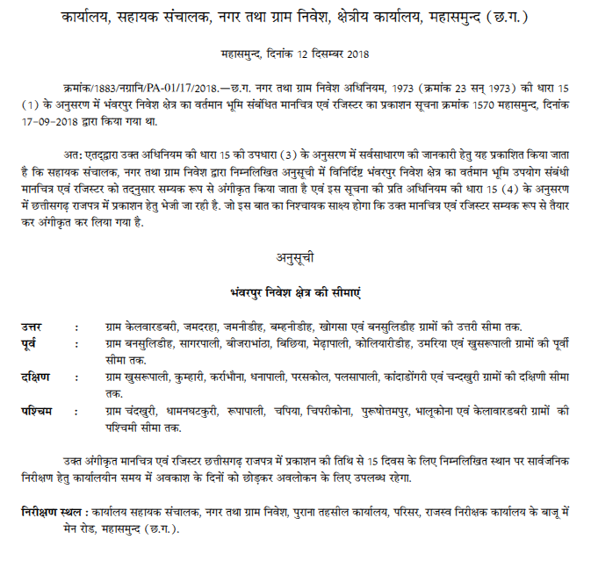

Gazette Notification of Final ELU u/s 15(4)

Slide 34
PLANNING STAGES
STAGE - III
Preparation of Development Plan
(Case Study of kanker, Chhattisgarh)
lapkyuky;] uxj rFkk xzke fuos’k] vVy uxj] NRrhlx<+

Slide 35
What is Development Plan?
Development Plan
The DP should be based on the Regional Plan of that area, if any
DP consists spatial development strategies for next 20 years which are based on the existing situation analysis and projections in terms of population and required basic infrastructure (physical as well as social)
Major outcome – allocation of various landuses, proposed road network in terms of Ring road, Bypass etc, quantification of required infrastructure and overall investment plan.

Slide 36
DATA COLLECTION AND EXISTING SITUATION ANALYSIS
Secondary Data Collection –
Socio-Economy
Physiography
Geology
Built Environment and Land-Use
Housing & Slums
Traffic & Transport
Physical & Social Infrastructure
Tourism
Heritage/ Conservation
Environmental resources
Ongoing and Approved Projects
Review of Existing Development Plan, if any
Situation Assessment
Demography
Regional Economy
Economic Sectors
Transport Sector
Physical Infrastructure
Social Amenities
Housing
Heritage and Conservation
Tourism
Water Resource Management
Review of Chhattisgarh T&CP Act, 1973
Review of State Level Policies:
Industrial Policy
Housing Policy
Tourism / Heritage Conservation
PPP Policy
URDPFI Guidelines
SWOT Analysis
Traffic Survey
Junction Improvement Survey
Environment Quality Survey
Identification of Data Gaps
Field Surveys (If required)
Population Projection for 2031
Land Utilisation Ratio (LUR)
Stakeholder Consultations

Slide 37
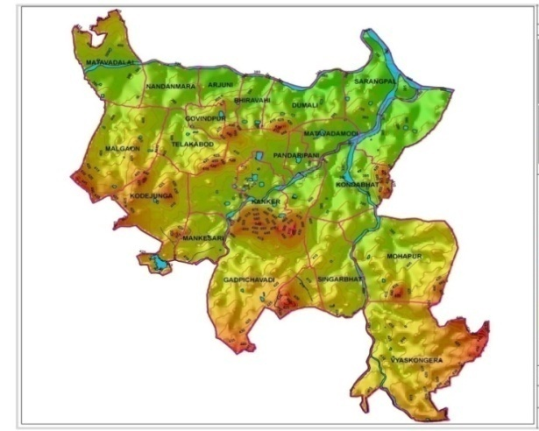
TOPOGRAPHY ANALYSIS
Digital Terrain Model
Low lands
High lands

Slide 38
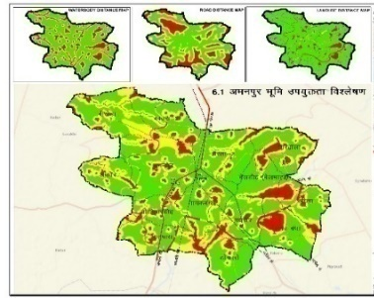
LANDUSE SUITABILITY ANALYSIS
Criteria for LSA -
Distance from Water body
Distance from Urban settlement
Distance from Road
Terrain
Ground Water Availability

Slide 39
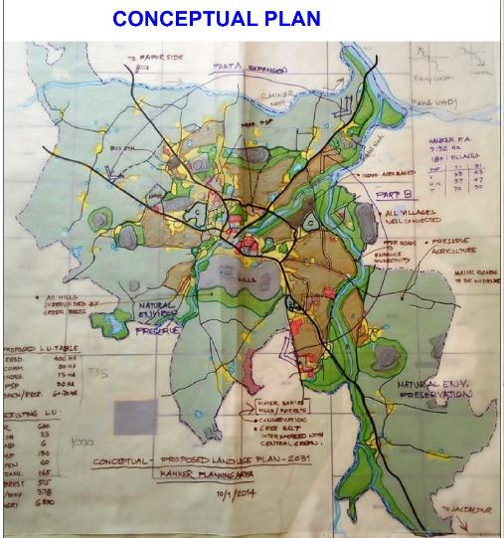
Conceptualisation of Development Plan
Having alternative Spatial development Options
Existing Landuse
Regional Linkages
Missing linkages
Topography
Natural Vegetation
Wind Direction
Eco sensitive zones
Heritage zones

Slide 40
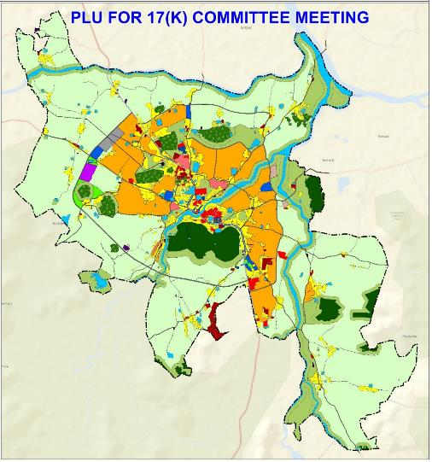
Preliminary Development Plan
Based on the final development option, a Preliminary Development Plan is prepared and presented to the committee formed u/s 17(K) for review and recommendations

Slide 41
17 d lfefr ds lnL;
Composition of
17(K) Committee
Ø- | lnL;
1 | egkikSj] uxj fuxe ;k v/;{k] uxjikfydk@uxj iapk;r
2 | v/;{k] ft+yk iapk;r
3 | lkaln] yksdlHkk {ks=
4 | fo/kk;d] fo/kkulHkk {ks=
5 | v/;{k] tuin iapk;r
6 | ljiap] xzke iapk;r ¼fuos’k {ks= dh izR;sd xzke iapk;r½
7 | izfrfuf/k] baLVhV~;wV vkWQ Vkmu Iykuj bafM;k
8 | izfrfuf/k] baLVhV~;wV vkWQ bathfu;lZ bafM;k
9 | izfrfuf/k] baLVhV~;wV vkWQ vkdhZVsDV
10 | dysDVj] ft+yk ;k izfrfuf/k
11 | iqfyl v/kh{kd] ft+yk ;k izfrfuf/k
12 | dk;Zikyu vfHk;ark] yksd LokLF; ;kaf=dh
13 | dk;Zikyu vfHk;ark] yksd fuekZ.k foHkkx
14 | lfefr dk la;kstd & {ks=h; la;qDr lapkyd] uxj rFkk xzke fuos’kA

Slide 42
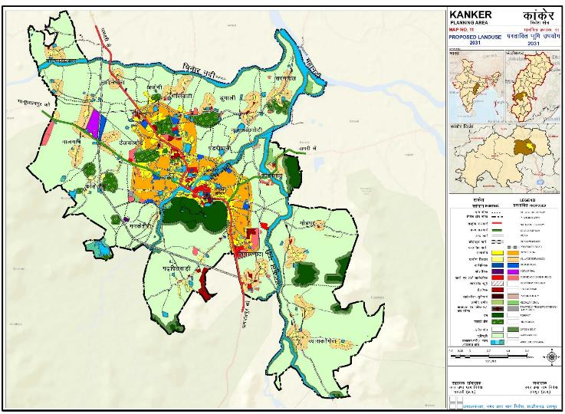
Draft Development Plan for Publication u/s 18(1) for 30 days to receive Objections and Suggestions
Prepared on the basis of recommendations of 17K committee and after scrutiny at Directorate level
lapkyuky;] uxj rFkk xzke fuos’k] vVy uxj] NRrhlx<+

Slide 43
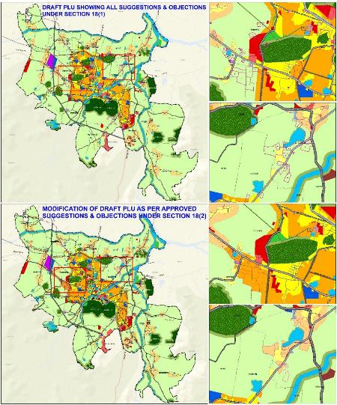
Marking of Objections/ Suggestions received on Draft DP and it’s hearing by the 17(K) committee
Modification of landuse as per approved Objections/ Suggestions
Submission of Draft DP to DT&CP u/s 18 (2)
Submission by DT&CP to the State Govt. with/ without modifications u/s 18(3)
lapkyuky;] uxj rFkk xzke fuos’k] vVy uxj] NRrhlx<+

Slide 44

Approval by State Govt. &
Notification of DP u/s 19(4)
lapkyuky;] uxj rFkk xzke fuos’k] vVy uxj] NRrhlx<+

Slide 45
TIMELINES from DRAFT to FINAL DEVELOPMENT PLAN
18(1) – Publication of
Draft Development Plan (DDP)
(30 Days)
Receiving of Suggestions/Objections on DDP
(60 Days)
18(2) – Hearing of Suggestions/Objections by 17(K) Committee
(90 Days)
Submission of Modified DDP to Director
(90 Days)
If
MODIFIED
18(3) – Submission of DDP to State Government
If REJECTED
19(2) – Notification of Modified Development Plan
If APPROVED
(30 Days)
19(3) – Hearing of Suggestions/ Objections & Approval of Final Development Plan
19 (4) – Publication of Final Development Plan

Slide 46
THANK YOU

